Slide 1

Manufacturing equipment
For effective use
of NON-waste wood
from furniture production
Anastasov Serghei

Slide 2
Fabricarea de echipamente pentru utilizarea eficientă a non-deșeuri din lemn în producția de mobilă.
Manufacturing of equipment for the effective use of non-waste wood from furniture production.
Изготовление комплекта оборудования для безотходного эффективного использования древесины в условиях мебельных производств.

Slide 3
1.Research and testing line matching wood and heating equipment.
2. Production equipment for NON-waste in wood processing.
Manufacturing of the equipment for the set line splicing and heating equipment:
Jointing bilateral machine;
Press jointing along;
Boiler, specialized in burning wood chips and small wood waste.

Slide 4

Benefits
Simple automation;
Low cost production;
Does not require a high level specialist servicing- an electrician or engineer;
Low cost compared to the commercial equivelent.

Slide 5
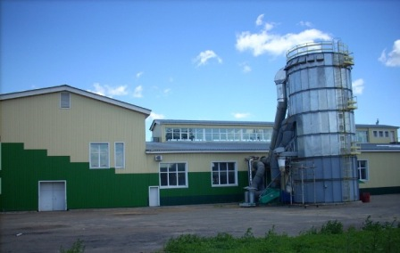
Potential Users of Innovation
Woodworking manufacturers and other enterprises which use wood for heating.

Slide 6
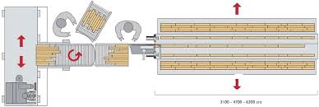

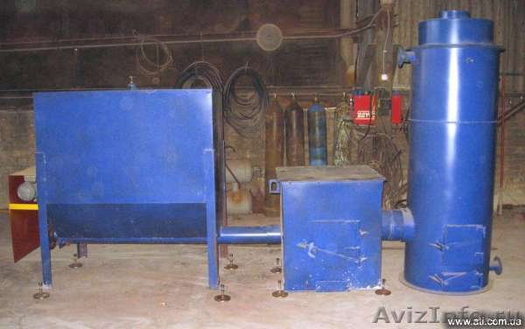
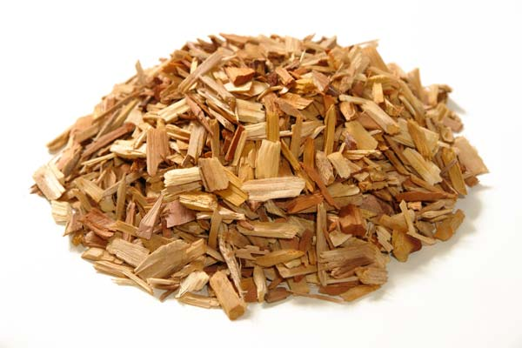
Main Product

Slide 7
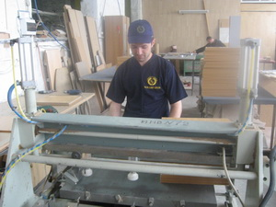
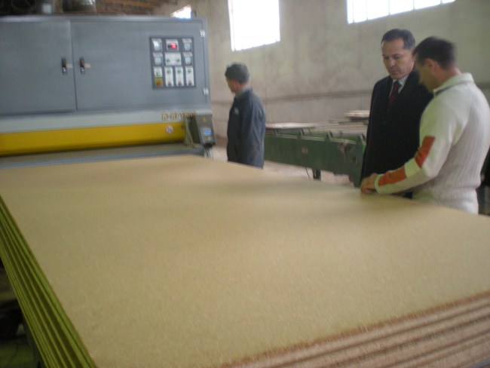
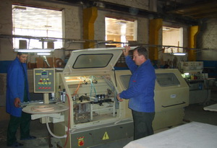
Viability project completion-100%
Contact
+373 69600550
E-mail: goloat-vita@mail.ru

